Slide 1
Edge Microgateway
Custom Plugins

Slide 2
Agenda
Custom Plugin Overview
Custom Plugin Lab

Slide 3
Plugin Overview
A plugin is a Node.js module that can implement one or more of following Microgateway events.
Plugins also allow you to extend the Microgateway and add new features.
Request events to override:
onrequest, ondata_request, onend_request, onclose_request, onerror_request
Response events to override:
onresponse, ondata_response, onend_response, onclose_response, onerror_response
‹#›
Notes:
If an event is not implemented in the Node.js script, then that event will not execute.

Slide 4
Plugin Event Architecture - Request
onrequest
ondata
_request
onend
_request
onclose
_request
onerror
_request
Called at start of request
Access headers, URL, query params, HTTP method
Call next()
Called when a chunk of data is received
Call next(null, data)
Called when all the data has been received
Call next(null, data)
Called when the client has closed the connection
Call next()
Called when there is an error receiving the client request
Call next()
‹#›
Notes:
You must call the next() function as the last line of code in each event handler
Onrequest_data, onresponse_data, Onend_request, onend_response
next(null, data);
All the other events can just call next()

Slide 5
Plugin Event Model - Request Flow
Plugin 1
onrequest
Plugin 2
onrequest
Plugin 3
onrequest
edgemicro:
...
plugins:
sequence:
- plugin1
- plugin2
- plugin3
Plugin 1
Onend
_request
Plugin 2
Onend
_request
Plugin 3
Onend
_request
‹#›

Slide 6
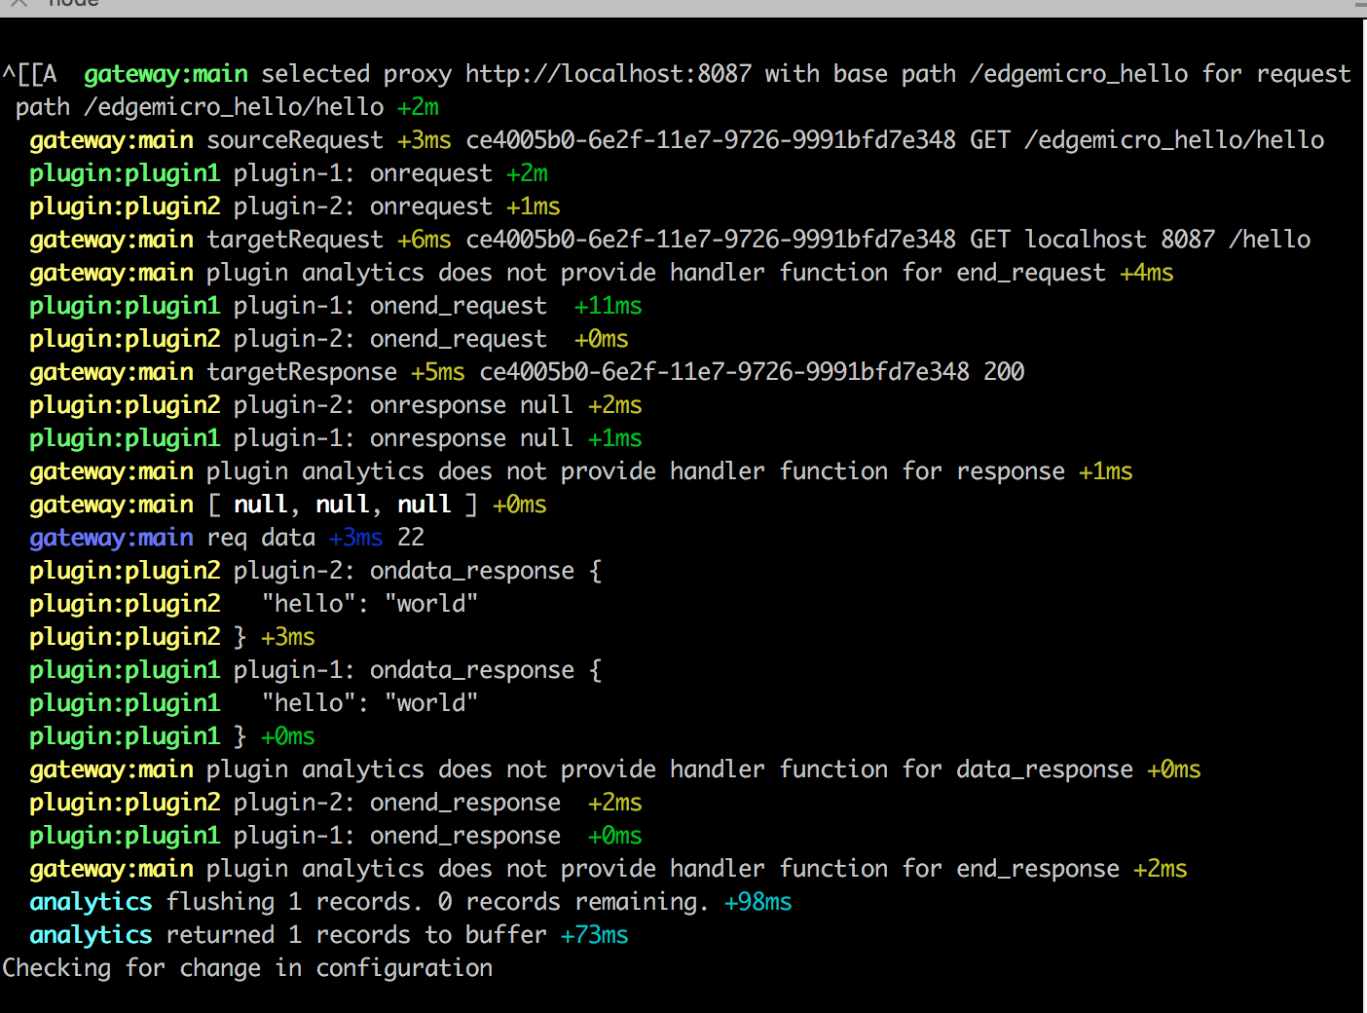
Plugin Event Model - Request Flow
‹#›

Slide 7
Plugin Event Architecture - Response
onresponse
ondata
_response
onend
_response
onclose
_response
onerror
_response
Called at start of target response
Access headers, URL, query params, HTTP method
Call next()
Called when a chunk of data is received
Call next(null, data)
Called when all the data has been received
Call next(null, data)
Called when the target has closed the connection
Call next()
Called when there is an error receiving the target response
Call next()
‹#›

Slide 8
Plugin Event Model - Response Flow
Plugin 3
onresponse
Plugin 2
onresponse
Plugin 1
onresponse
edgemicro:
...
plugins:
sequence:
- plugin1
- plugin2
- plugin3
Plugin 3
ondata
_response
data1
Plugin 2
ondata
_response
data1
Plugin 1
ondata
_response
data1
Plugin 3
ondata
_response
data2
Plugin 2
ondata
_response
data2
Plugin 1
ondata
_response
data2
Plugin 3
onend
_response
Plugin 2
onend
_response
Plugin 1
onend
_response
‹#›

Slide 9
Plugin Event Model - Request Flow
‹#›

Slide 10
Plugin Setup
Custom plugins are stored in the folder below
[prefix]/npm/lib/node_modules/edgemicro/plugins
A new folder should be created in the ‘plugins’ directory
Initialize the plugin directory with the following command
cd [prefix]/npm/lib/node_modules/edgemicro/plugins
mkdir myplugin
cd myplugin
npm init
Custom plugin folder should contain a file named index.js, which implements one or more of the Microgateway request or response events.
‹#›
Notes:
Attendees will learn more about this during the lab

Slide 11
Update Edge Microgateway Configuration
Edgemicro gateway configuration (partial view) is stored in the following file:
~/.edgemicro/org-env-config.yaml
Custom plugins must be included in the sequence section.
edgemicro:
...
plugins:
sequence:
- oauth
- myplugin
‹#›

Slide 12

Things to remember when writing a plugin:
Request / response handlers must call next() when done processing. If not, processing will stop and the request will hang.
The first argument to next() may be an error which will cause processing to terminate.
The ondata_ and onend_ handlers must call next() with a second argument containing the data to be passed to the target or the client. It can be null if the plugin is buffering and does not have enough data to transform at the moment.
A single instance of the plugin is used to service all requests and responses. If per-request state needs to be retained between handler calls, it can be saved in a property added to the supplied request object, whose lifetime is the duration of the API call.
Catch all errors and call next() with the error. If not, the API call will hang.
Do not perform compute-intensive tasks in the main thread as this can adversely affect performance.
Plugin Authoring

Slide 13
Microgateway Labs
Complete the following Edge Microgateway Lab.
Lab - Create a Custom Plugin
‹#›

Slide 14
THANK YOU

